Slide 1
EEE440 - Computer Architecture
The Processor: Datapath and Control
(Chapter 5)

Slide 2
Implementing MIPS
We're ready to look at an implementation of the MIPS instruction set
Simplified to contain only
  arithmetic-logic instructions: add, sub, and, or, slt
  memory-reference instructions: lw, sw
  control-flow instructions: beq, j
6 bits
5 bits
5 bits
5 bits
5 bits
6 bits
op
rs
rt
rd
shamt
funct
R-Format
6 bits
5 bits
5 bits
16 bits
op
rs
rt
offset
I-Format
6 bits
26 bits
J-Format
op
address

Slide 3
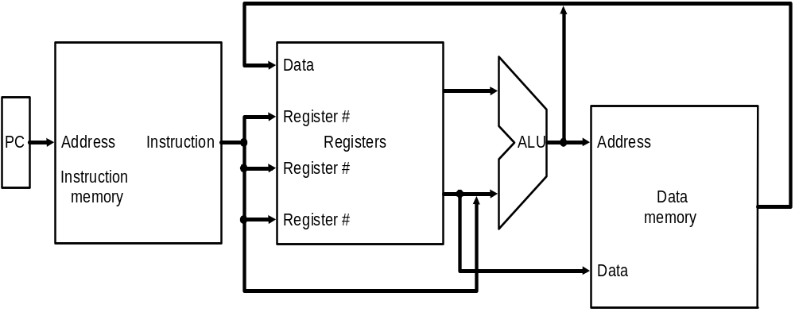
Implementing MIPS: the Fetch/Execute Cycle
High-level abstract view of fetch/execute implementation
  use the program counter (PC) to read instruction address
  fetch the instruction from memory and increment PC
  use fields of the instruction to select registers to read
  execute depending on the instruction
  repeat…

Slide 4
Overview: Processor Implementation Styles
Single Cycle
  perform each instruction in 1 clock cycle
  clock cycle must be long enough for slowest instruction; therefore,
  disadvantage: only as fast as slowest instruction
Multi-Cycle
  break fetch/execute cycle into multiple steps
  perform 1 step in each clock cycle
  advantage: each instruction uses only as many cycles as it needs
Pipelined
  execute each instruction in multiple steps
  perform 1 step / instruction in each clock cycle
  process multiple instructions in parallel – assembly line

Slide 5
Functional Elements
Two types of functional elements in the hardware:
  elements that operate on data (called combinational elements)
  elements that contain data (called state or sequential elements)

Slide 6

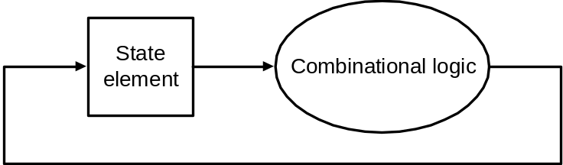
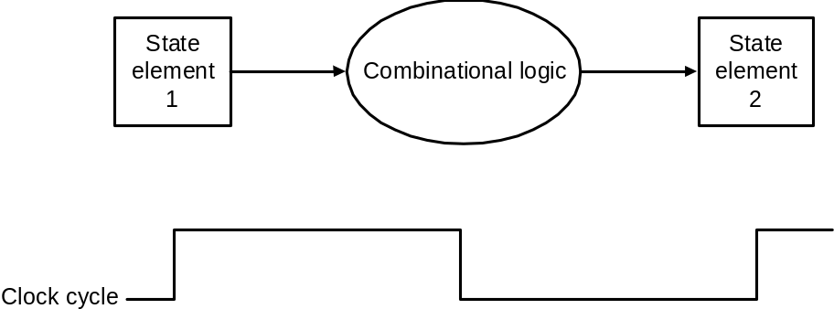
Combinational Elements
Works as an input ⇒ output function, e.g., ALU
Combinational logic reads input data from one register and writes output data to another, or same, register
  read/write happens in a single cycle – combinational element cannot store data from one cycle to a future one
Combinational logic hardware units

Slide 7
State Elements
State elements contain data in internal storage, e.g., registers and memory
All state elements together define the state of the machine
  What does this mean? Think of shutting down and starting up again…
Flipflops and latches are 1-bit state elements, equivalently, they are 1-bit memories
The output(s) of a flipflop or latch always depends on the bit value stored, i.e., its state, and can be called 1/0 or high/low or true/false
The input to a flipflop or latch can change its state depending on whether it is clocked or not…

Slide 8
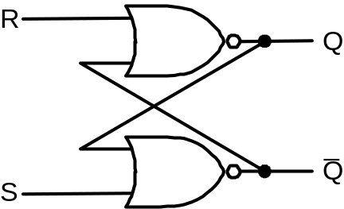
Set-Reset (SR-) latch
(unclocked)
A set-reset latch made from two cross-coupled
nand gates is a basic memory unit.
When both Sbar and Rbar are 1, then either one
of the following two states is stable:
Q = 1 & Qbar = 0
Q = 0 & Qbar = 1
and the latch will continue in the current stable
state.
If Sbar changes to 0 (while Rbar remains at 1),
then the latch is forced to the exactly one
possible stable state (a). If Rbar changes to 0
(while Sbar remains at 1), the latch is forced to
the exactly one possible stable state (b).
So, the latch remembers which of Sbar or Rbar
was last 0 during the time they are both 1.
When both Sbar and Rbar are 0 the exactly one
stable state is Q = Qbar = 1. However, if after
that both Sbar and Rbar return to 1, the latch must
then jump non-deterministically to one of stable
states (a) or (b), which is undesirable behavior.
Think of Sbar as S, the inverse of set (which
sets Q to 1), and Rbar as R, the inverse of reset.
Sbar(set)
n1
Q
Rbar
(reset)
n2
Qbar
See sr_latch.v in Verilog Examples
equivalently with nor gates

Slide 9
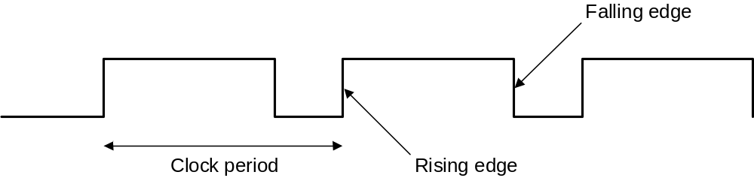
Synchronous Logic:
Clocked Latches and Flipflops
Clocks are used in synchronous logic to determine when a state element is to be updated
  in level-triggered clocking methodology either the state changes only when the clock is high or only when it is low (technology-dependent)
  in edge-triggered clocking methodology either the rising edge or falling edge is active (depending on technology) – i.e., states change only on rising edges or only on falling edge
Latches are level-triggered
Flipflops are edge-triggered

Slide 10
Clocked SR-latch
State can change only when clock is high
Potential problem : both inputs Sbar = 0 & Rbar = 0 will cause non-deterministic behavior
Sbar
X
r1
n1
Q
clk
a
clkbar
Rbar
r2
n2
Qbar
Y
See clockedSr_latch.v in Verilog Examples

Slide 11
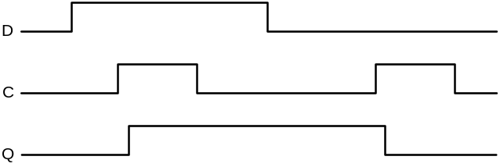
Clocked D-latch
State can change only when clock is high
Only single data input (compare SR-latch)
No problem with non-deterministic behavior
D
a2
Dbar
X
r1
n1
Q
clk
clkbar
a1
r2
n2
Qbar
Y
See clockedD_latch.v in Verilog Examples
Timing diagram of D-latch

Slide 12
Clocked D-flipflop
Negative edge-triggered
Made from three SR-latches
sbar
clear
cbar
s
q
clkbar
clk
r
qbar
rbar
d
See edge_dffGates.v in Verilog Examples

Slide 13
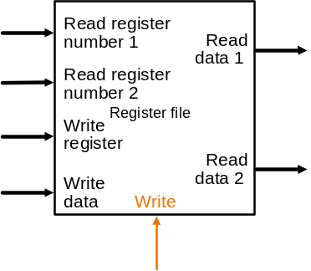
State Elements on the Datapath: Register File
Registers are implemented with arrays of D-flipflops
Clock
5 bits
32 bits
5 bits
5 bits
32 bits
32 bits
Control signal
Register file with two read ports and
one write port

Slide 14
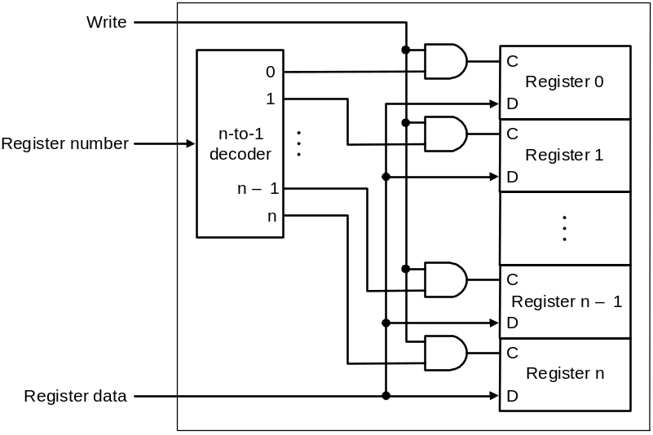
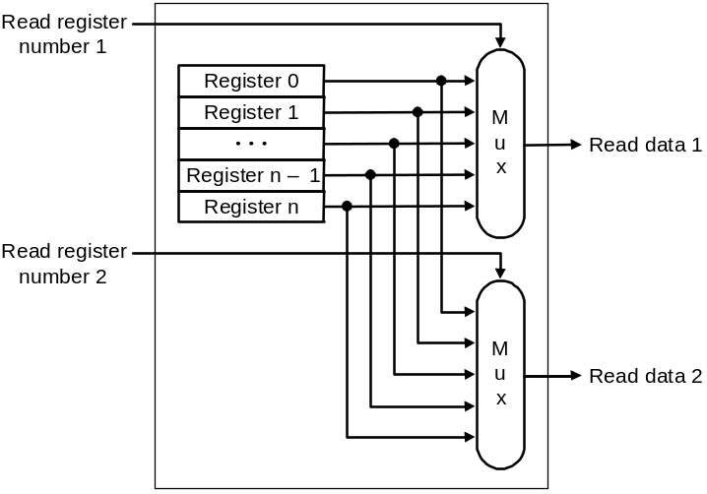
State Elements on the Datapath: Register File
Port implementation:
Clock
Clock
Read ports are implemented
with a pair of multiplexors – 5
bit multiplexors for 32 registers
Write port is implemented using
a decoder – 5-to-32 decoder for
32 registers. Clock is relevant to
write as register state may change
only at clock edge

Slide 15
Verilog
All components that we have discussed – and shall discuss – can be fabricated using Verilog
Refer to our Verilog slides and examples

Slide 16
Single-cycle Implementation of MIPS
Our first implementation of MIPS will use a single long clock cycle for every instruction
Every instruction begins on one up (or, down) clock edge and ends on the next up (or, down) clock edge
This approach is not practical as it is much slower than a multicycle implementation where different instruction classes can take different numbers of cycles
  in a single-cycle implementation every instruction must take the same amount of time as the slowest instruction
  in a multicycle implementation this problem is avoided by allowing quicker instructions to use fewer cycles
Even though the single-cycle approach is not practical it is simple and useful to understand first
Note : we shall implement jump at the very end

Slide 17
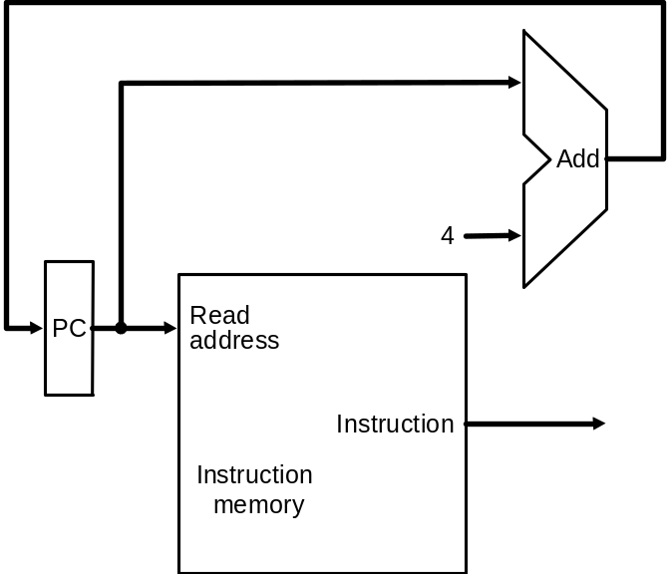
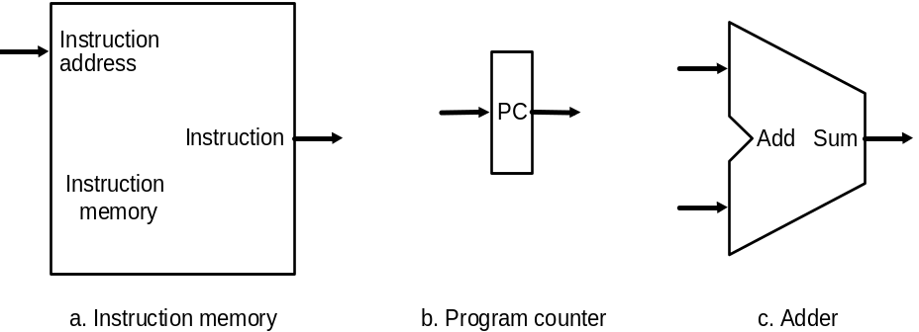
Datapath: Instruction Store/Fetch & PC Increment
Three elements used to store
and fetch instructions and
increment the PC
Datapath

Slide 18
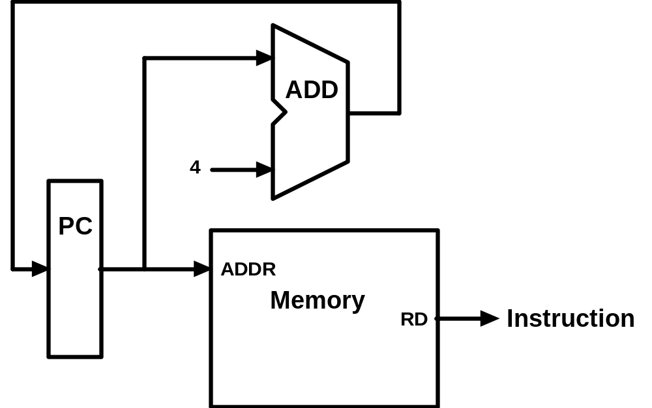
Animating the Datapath
Instruction <- MEM[PC]
PC <- PC + 4

Slide 19
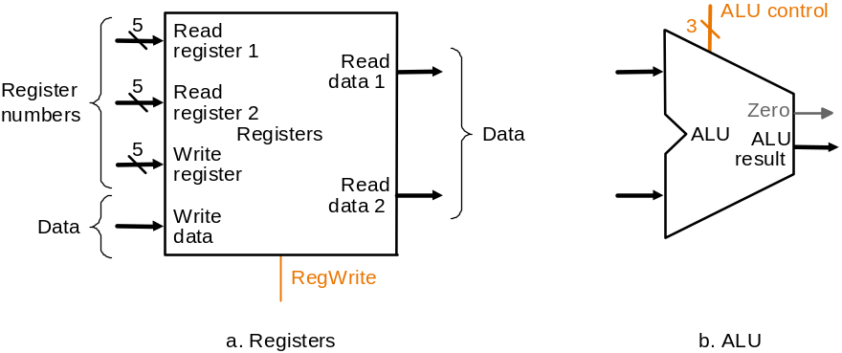
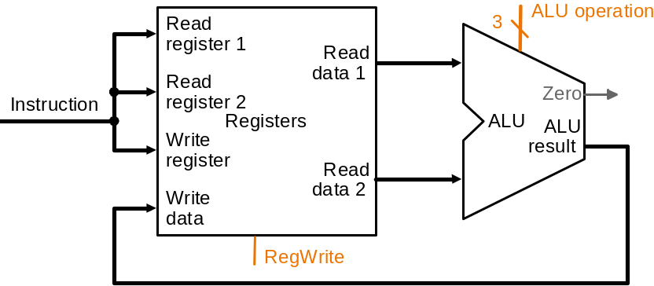
Datapath: R-Type Instruction
Two elements used to implement
R-type instructions
Datapath

Slide 20
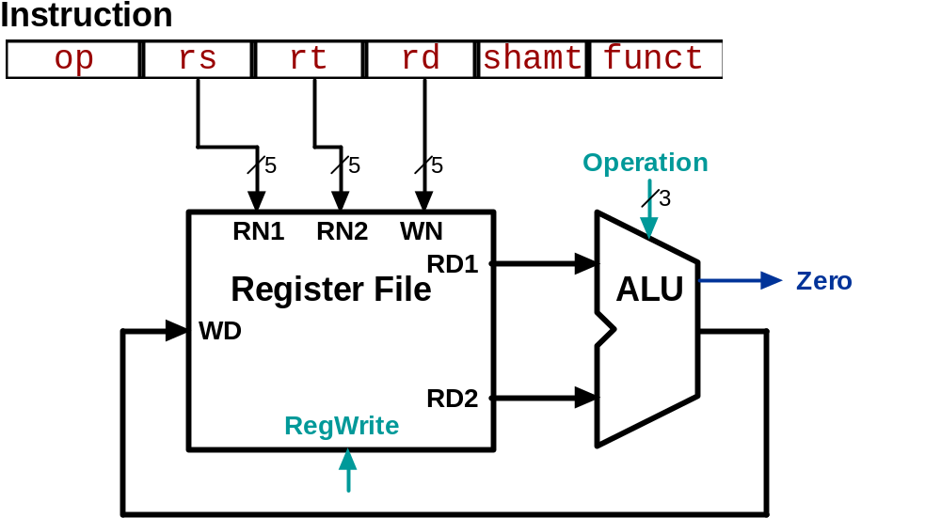
Animating the Datapath
add rd, rs, rt
R[rd] <- R[rs] + R[rt];

Slide 21
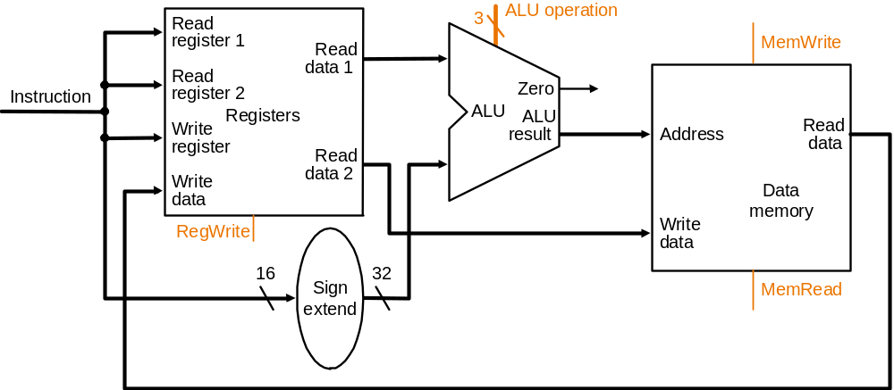
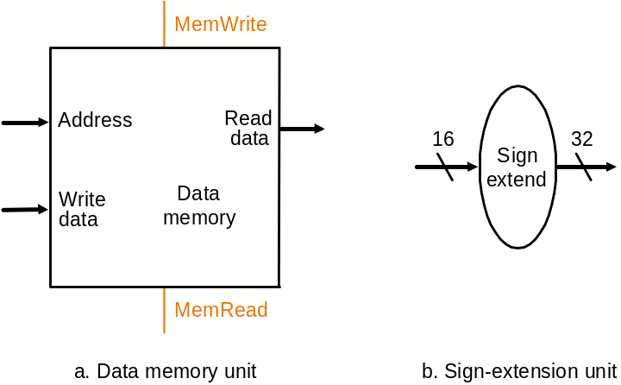
Datapath:
Load/Store Instruction
Two additional elements used
To implement load/stores
Datapath

Slide 22
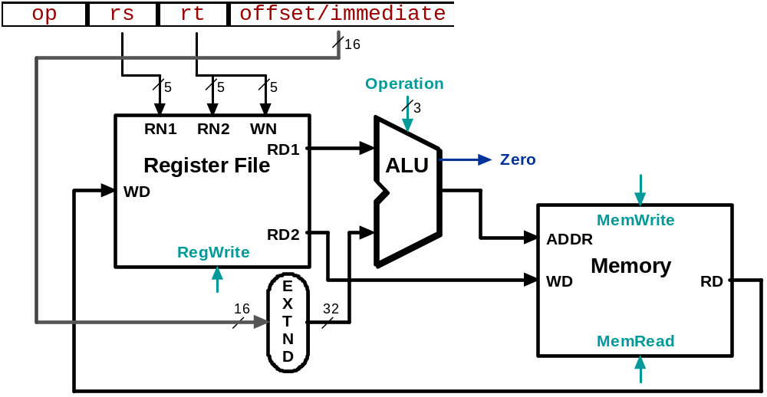
Animating the Datapath
lw rt, offset(rs)
R[rt] <- MEM[R[rs] + s_extend(offset)];

Slide 23
Animating the Datapath
sw rt, offset(rs)
MEM[R[rs] + sign_extend(offset)] <- R[rt]

Slide 24
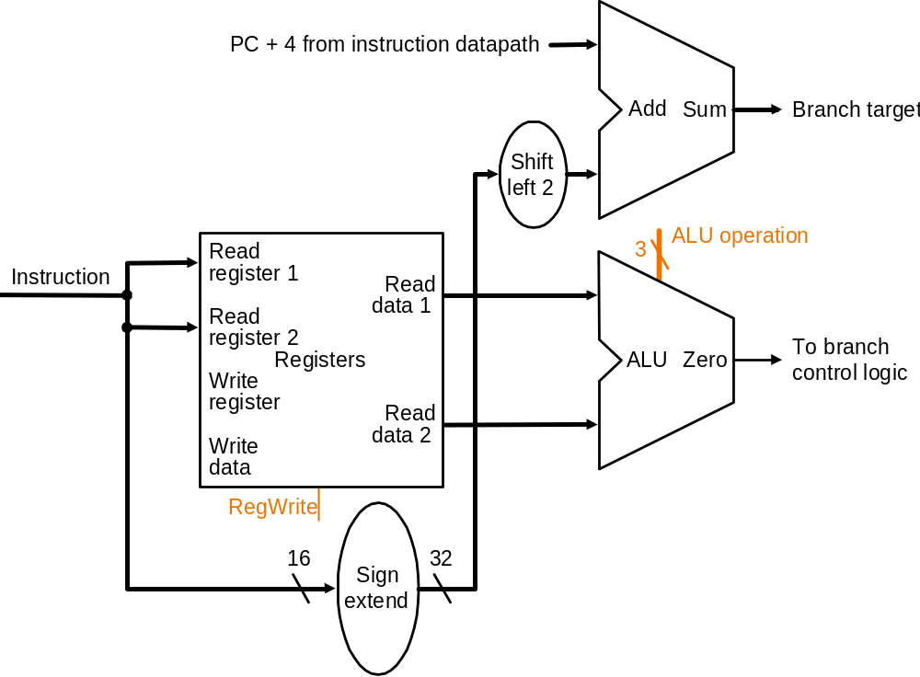
Datapath: Branch Instruction
No shift hardware required:
simply connect wires from
input to output, each shifted
left 2 bits
Datapath

Slide 25
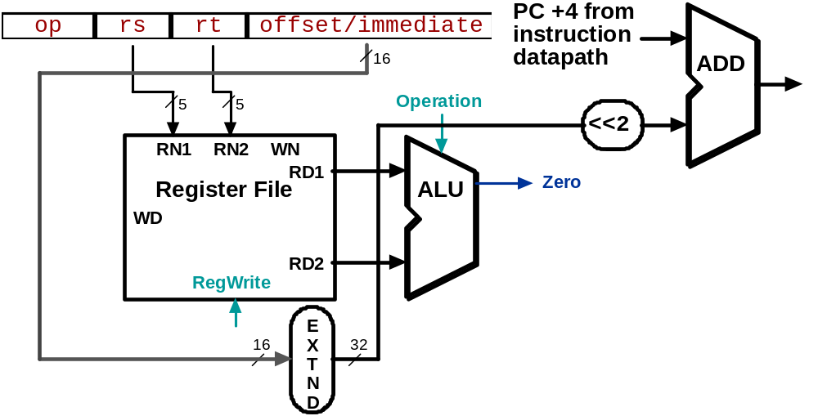
Animating the Datapath
beq rs, rt, offset
  if (R[rs] == R[rt]) then
  PC <- PC+4 + s_extend(offset<<2)

Slide 26
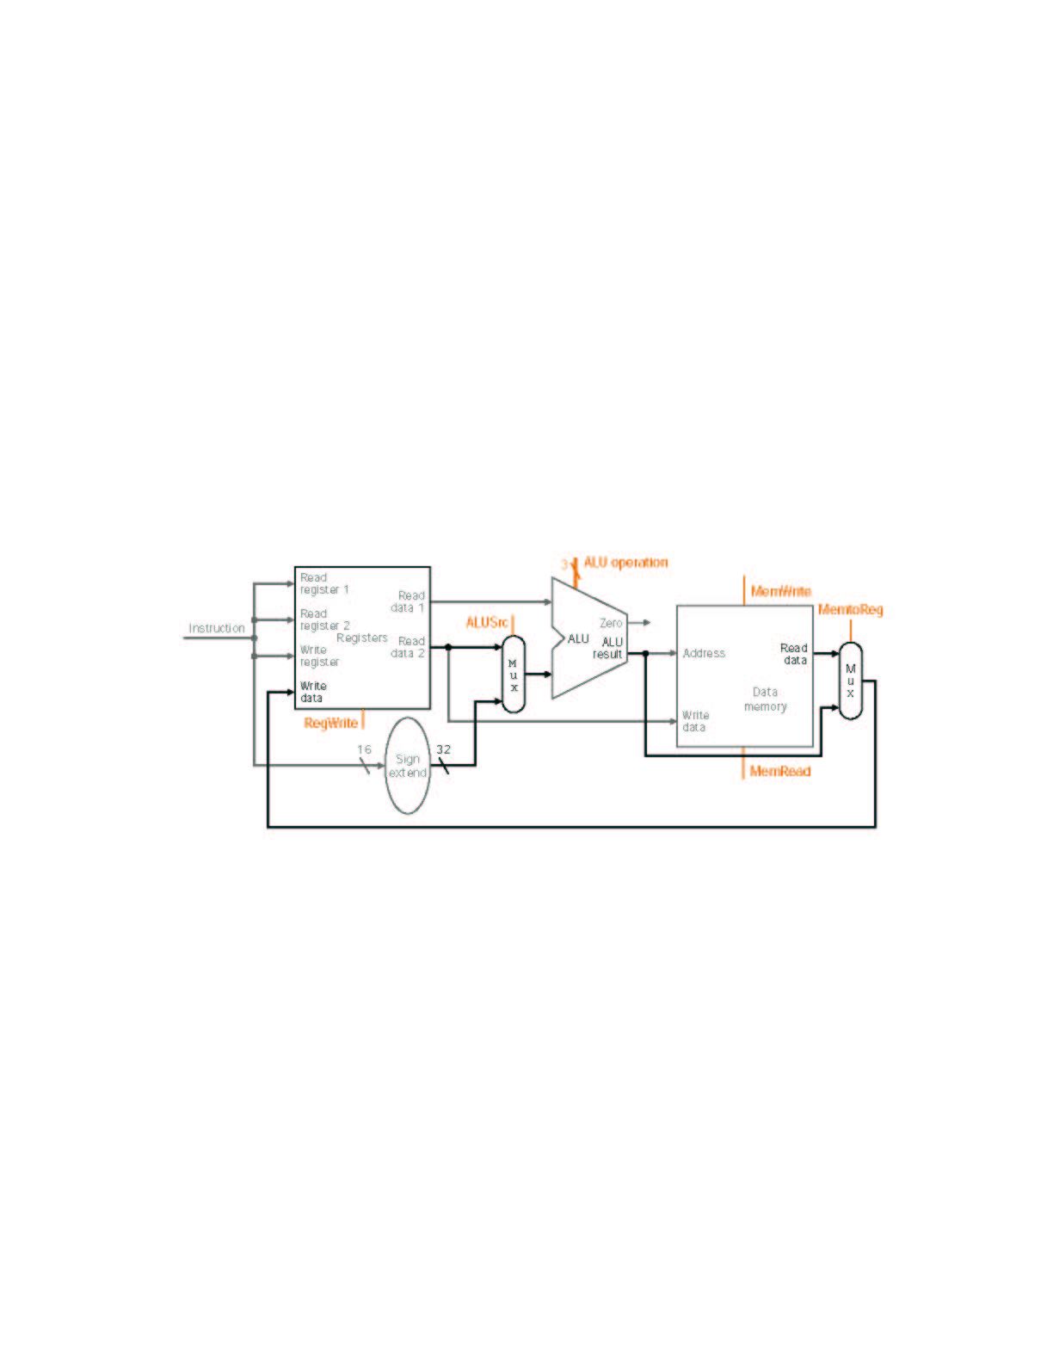
MIPS Datapath I: Single-Cycle
Input is either register (R-type) or sign-extended
lower half of instruction (load/store)
Data is either
from ALU (R-type)
or memory (load)
Combining the datapaths for R-type instructions
and load/stores using two multiplexors

Slide 27
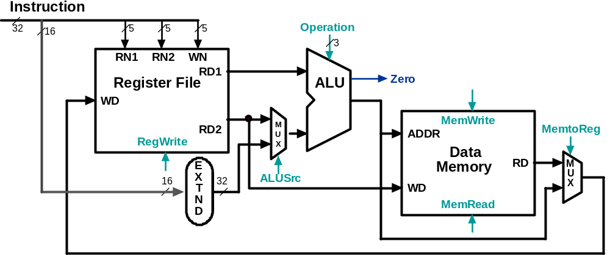
Animating the Datapath:
R-type Instruction
add rd,rs,rt

Slide 28
Animating the Datapath:
Load Instruction
lw rt,offset(rs)

Slide 29
Animating the Datapath:
Store Instruction
sw rt,offset(rs)

Slide 30
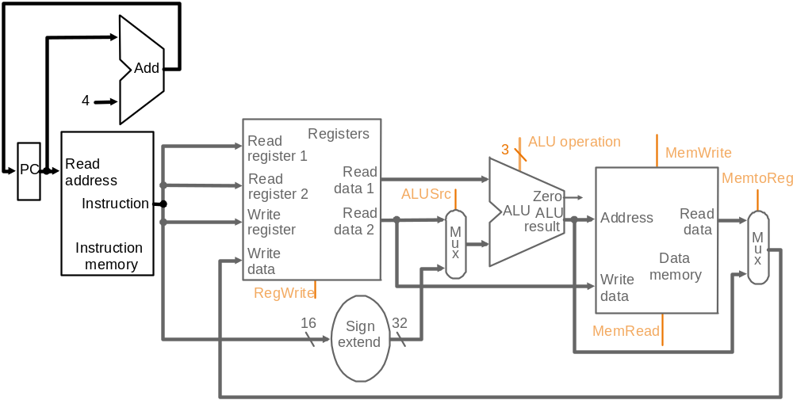
MIPS Datapath II: Single-Cycle
Separate adder as ALU operations and PC
increment occur in the same clock cycle
Separate instruction memory
as instruction and data read
occur in the same clock cycle
Adding instruction fetch

Slide 31
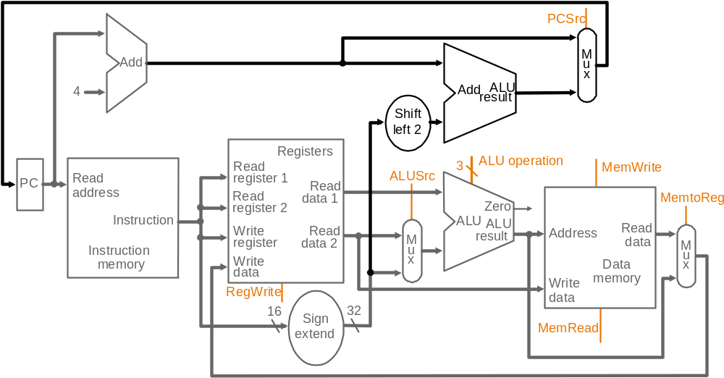
MIPS Datapath III: Single-Cycle
New multiplexor
Extra adder needed as both
adders operate in each cycle
Instruction address is either
PC+4 or branch target address
Adding branch capability and another multiplexor
Important note: in a single-cycle implementation data cannot be stored
during an instruction – it only moves through combinational logic
Question: is the MemRead signal really needed?! Think of RegWrite…!

Slide 32
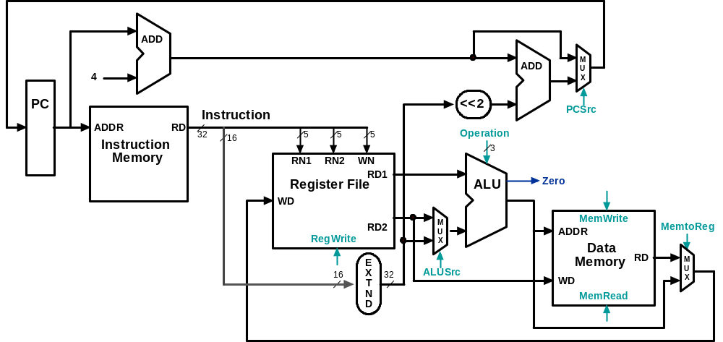
Datapath Executing add
add rd, rs, rt

Slide 33
Datapath Executing lw
lw rt,offset(rs)

Slide 34
Datapath Executing sw
sw rt,offset(rs)

Slide 35
Datapath Executing beq
beq r1,r2,offset

Slide 36
Control
Control unit takes input from
  the instruction opcode bits
Control unit generates
  ALU control input
  write enable (possibly, read enable also) signals for each storage element
  selector controls for each multiplexor

Slide 37
ALU Control
Plan to control ALU: main control sends a 2-bit ALUOp control field to the ALU control. Based on ALUOp and funct field of instruction the ALU control generates the 3-bit ALU control field
  ALU control Func-
field tion
000 and
001 or
010 add
110 sub
111 slt
ALU must perform
  add for load/stores (ALUOp 00)
  sub for branches (ALUOp 01)
  one of and, or, add, sub, slt for R-type instructions, depending on the instruction’s 6-bit funct field (ALUOp 10)
Recall from Ch. 4
2
ALUOp
3
Main
Control
ALU
Control
To
ALU
ALU
control
input
6
Instruction
funct field
ALUOp generation
by main control

Slide 38
Setting ALU Control Bits
Instruction AluOp Instruction Funct Field Desired ALU control
opcode operation ALU action input
LW 00 load word xxxxxx add 010
SW 00 store word xxxxxx add 010
Branch eq 01 branch eq xxxxxx subtract 110
R-type 10 add 100000 add 010
R-type 10 subtract 100010 subtract 110
R-type 10 AND 100100 and 000
R-type 10 OR 100101 or 001
R-type 10 set on less 101010 set on less 111
ALUOp
Funct field
Operation
ALUOp1
ALUOp0
F5
F4
F3
F2
F1
F0
*Typo in text
Fig. 5.15: if it is X
then there is potential
conflict between
line 2 and lines 3-7!
0
0
X
X
X
X
X
X
010
*
0
1
X
X
X
X
X
X
110
1
X
X
X
0
0
0
0
010
1
X
X
X
0
0
1
0
110
1
X
X
X
0
1
0
0
000
1
X
X
X
0
1
0
1
001
1
X
X
X
1
0
1
0
111
Truth table for ALU control bits

Slide 39
Designing the Main Control
R-type
opcode
rs
rt
rd
shamt
funct
31-26
25-21
20-16
15-11
10-6
5-0
Load/store
or branch
opcode
rs
rt
address
31-26
25-21
20-16
15-0
Observations about MIPS instruction format
  opcode is always in bits 31-26
  two registers to be read are always rs (bits 25-21) and rt (bits 20-16)
  base register for load/stores is always rs (bits 25-21)
  16-bit offset for branch equal and load/store is always bits 15-0
  destination register for loads is in bits 20-16 (rt) while for R-type instructions it is in bits 15-11 (rd) (will require multiplexor to select)

Slide 40
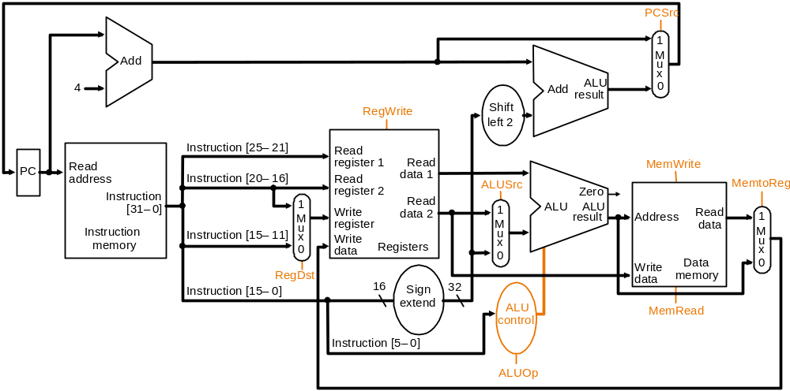
Datapath with Control I
New multiplexor
Adding control to the MIPS Datapath III (and a new multiplexor to select field to
specify destination register): what are the functions of the 9 control signals?

Slide 41
Control Signals
Signal Name Effect when deasserted Effect when asserted
RegDst The register destination number for the The register destination number for the
Write register comes from the rt field (bits 20-16) Write register comes from the rd field (bits 15-11)
RegWrite None The register on the Write register input is written
with the value on the Write data input
AlLUSrc The second ALU operand comes from the The second ALU operand is the sign-extended,
second register file output (Read data 2) lower 16 bits of the instruction
PCSrc The PC is replaced by the output of the adder The PC is replaced by the output of the adder
that computes the value of PC + 4 that computes the branch target
MemRead None Data memory contents designated by the address
input are put on the first Read data output
MemWrite None Data memory contents designated by the address
input are replaced by the value of the Write data input
MemtoReg The value fed to the register Write data input The value fed to the register Write data input
comes from the ALU comes from the data memory
Effects of the seven control signals

Slide 42
MIPS Registers
Name | Reg. No. | Usage | Preserved on Call?
$zero | 0 | const. value | n.a.
$v0 - $v1 | 2-3 | values | No
$a0 - $a3 | 4-7 | arguments | Yes
$t0 - $t7 | 8-15 | temporaries | No
$s0 - $s7 | 16-23 | saved | Yes
$t8 - $t9 | 24-25 | temporaries | No
$gp | 28 | Global pointer | Yes
$sp | 29 | Stack pointer | Yes
$fp | 30 | Frame Pointer | Yes
$ra | 31 | Return address | Yes

Slide 43
Category | Instr | Op Code | Example | Meaning
Arithmetic (R & I format) | add | 0 and 32 | add $s1, $s2, $s3 | $s1 = $s2 + $s3
 | subtract | 0 and 34 | sub $s1, $s2, $s3 | $s1 = $s2 - $s3
 | add immediate | 8 | addi $s1, $s2, 6 | $s1 = $s2 + 6
 | or immediate | 13 | ori $s1, $s2, 6 | $s1 = $s2 v 6
Data Transfer (I format) | load word | 35 | lw $s1, 24($s2) | $s1 = Memory($s2+24)
 | store word | 43 | sw $s1, 24($s2) | Memory($s2+24) = $s1
 | load byte | 32 | lb $s1, 25($s2) | $s1 = Memory($s2+25)
 | store byte | 40 | sb $s1, 25($s2) | Memory($s2+25) = $s1
 | load upper imm | 15 | lui $s1, 6 | $s1 = 6 * 2¹⁶
Cond. Branch (I & R format) | br on equal | 4 | beq $s1, $s2, L | if ($s1==$s2) go to L
 | br on not equal | 5 | bne $s1, $s2, L | if ($s1 !=$s2) go to L
 | set on less than | 0 and 42 | slt $s1, $s2, $s3 | if ($s2<$s3) $s1=1 else $s1=0
 | set on less than immediate | 10 | slti $s1, $s2, 6 | if ($s2<6) $s1=1 else $s1=0
Uncond. Jump (J & R format) | jump | 2 | j 2500 | go to 10000
 | jump register | 0 and 8 | jr $t1 | go to $t1
 | jump and link | 3 | jal 2500 | go to 10000; $ra=PC+4
Notes:
similarity of the binary representation of related instructions simplifies the hardware design

Slide 44
Add Instruction
Instructions, like registers and words of data, are 32 bits long
Arithmetic Instruction Format (R format):
add $t0, $s1, $s2
op rs rt rd shamt funct
op 6-bits opcode that specifies the operation
rs 5-bits register file address of the first source operand
rt 5-bits register file address of the second source operand
rd 5-bits register file address of the result’s destination
shamt 5-bits shift amount (for shift instructions)
funct 6-bits function code augmenting the opcode
EE204 L04-ISA

Slide 45
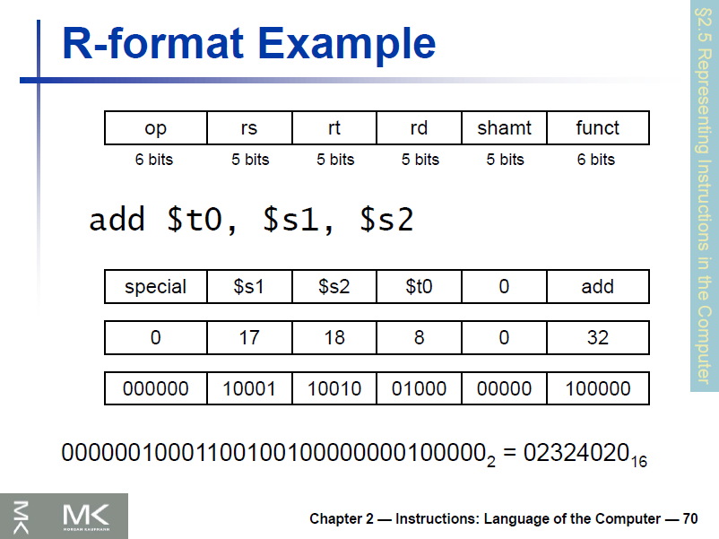
EEE-440

Slide 46
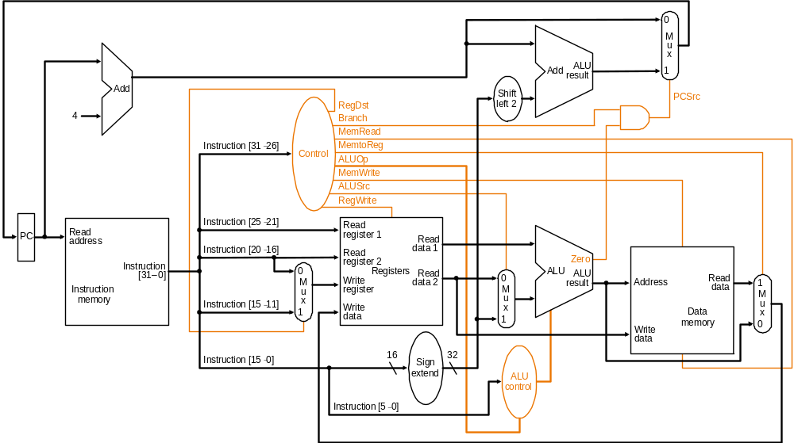
Datapath with Control II
MIPS datapath with the control unit: input to control is the 6-bit instruction
opcode field, output is seven 1-bit signals and the 2-bit ALUOp signal

Slide 47
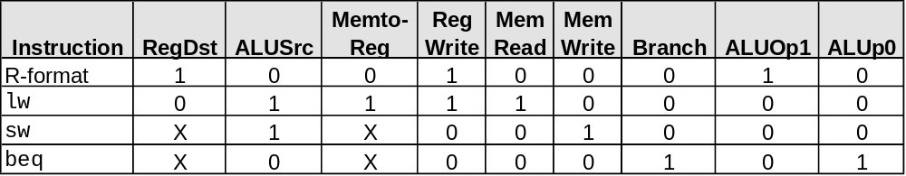
Datapath with
Control II (cont.)
PCSrc cannot be
set directly from the
opcode: zero test
outcome is required
Determining control signals for the MIPS datapath based on instruction opcode

Slide 48
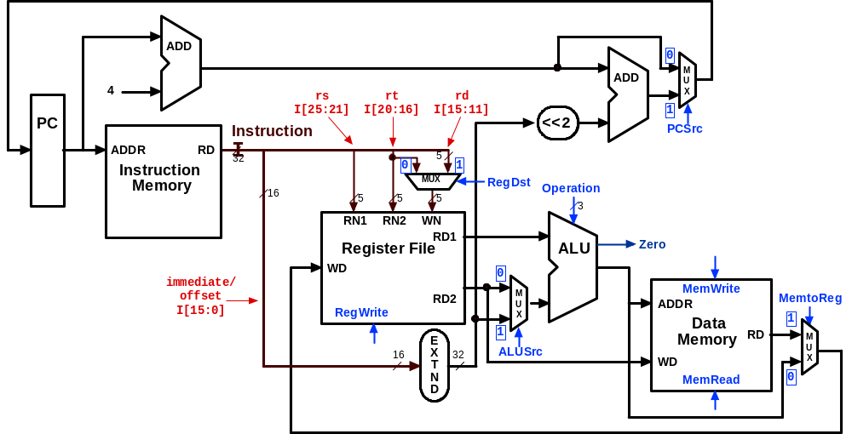
Control Signals:
R-Type Instruction
0
???
Value depends on funct
1
0
0
1
Control signals
shown in blue
0
0

Slide 49
Control Signals: lw Instruction
0
010
0
0
1
1
Control signals
shown in blue
1
1

Slide 50
Control Signals: sw Instruction
0
010
X
1
X
0
Control signals
shown in blue
1
0

Slide 51
Control Signals: beq Instruction
1 if Zero=1
110
X
0
X
0
Control signals
shown in blue
0
0

Slide 52
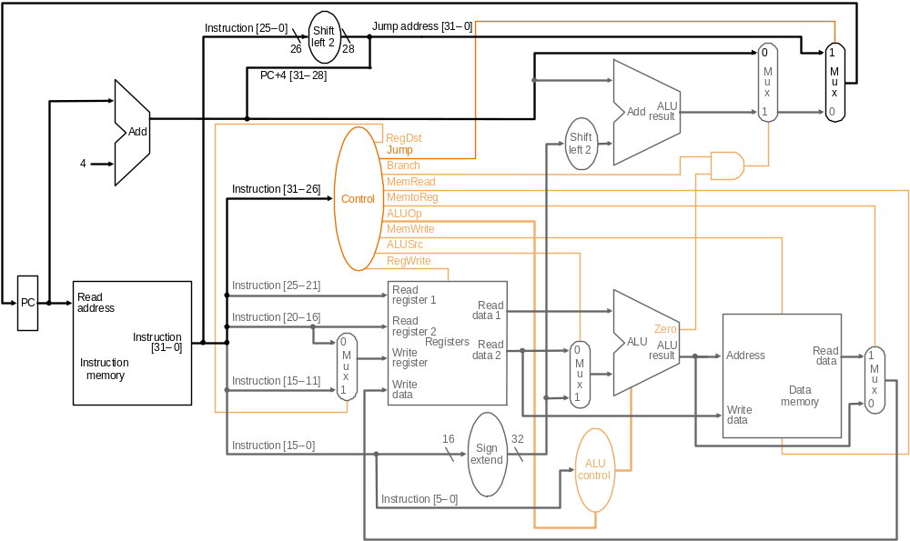
Datapath with Control III
Jump
opcode
address
31-26
Composing jump
target address
25-0
New multiplexor with additional
control bit Jump
MIPS datapath extended to jumps: control unit generates new Jump control bit

Slide 53
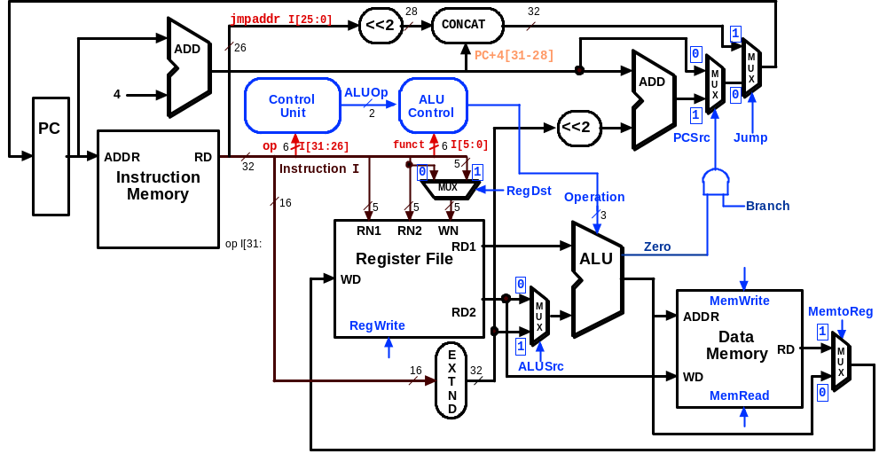
Datapath Executing j

Slide 54
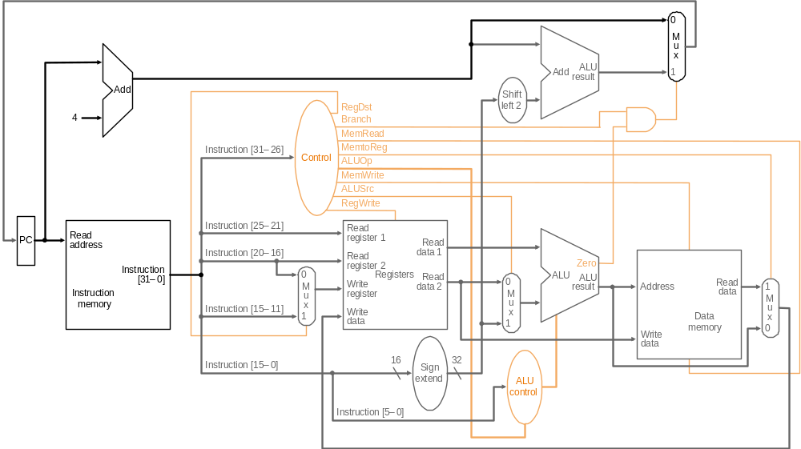
R-type Instruction: Step 1 add $t1, $t2, $t3 (active = bold)
Fetch instruction and increment PC count

Slide 55
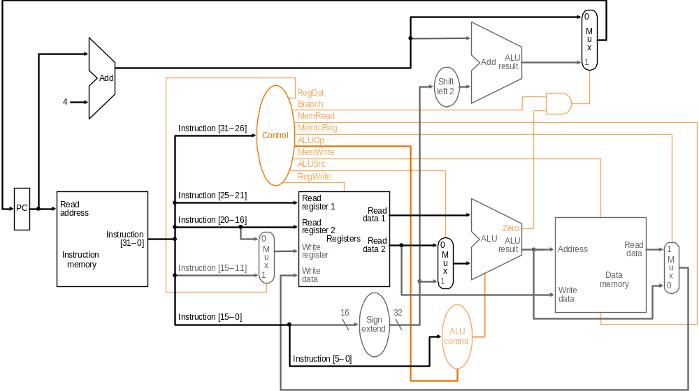
R-type Instruction: Step 2 add $t1, $t2, $t3 (active = bold)
Read two source registers from the register file

Slide 56
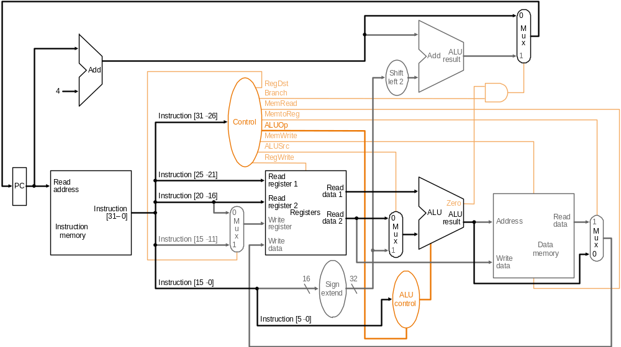
R-type Instruction: Step 3 add $t1, $t2, $t3 (active = bold)
ALU operates on the two register operands

Slide 57
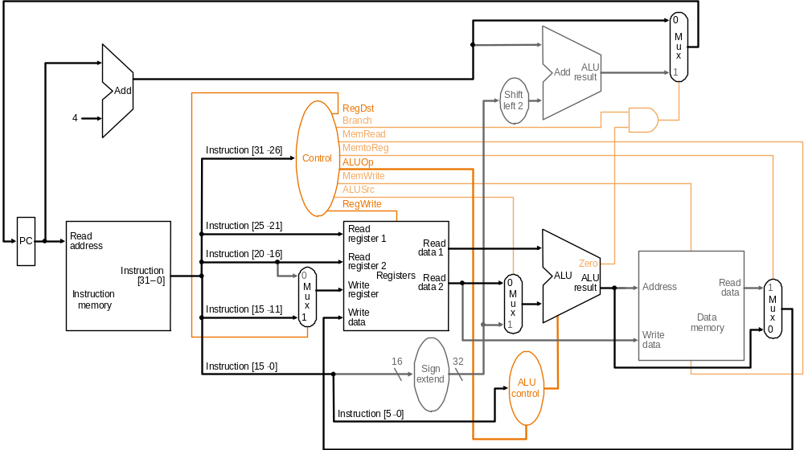
R-type Instruction: Step 4 add $t1, $t2, $t3 (active = bold)
Write result to register

Slide 58
Single-cycle Implementation Notes
The steps are not really distinct as each instruction completes in exactly one clock cycle – they simply indicate the sequence of data flowing through the datapath
The operation of the datapath during a cycle is purely combinational – nothing is stored during a clock cycle
Therefore, the machine is stable in a particular state at the start of a cycle and reaches a new stable state only at the end of the cycle
Very important for understanding single-cycle computing:
See our simple Verilog single-cycle computer in the folder SimpleSingleCycleComputer in Verilog/Examples

Slide 59
Load Instruction Steps lw $t1, offset($t2)
Fetch instruction and increment PC
Read base register from the register file: the base register ($t2) is given by bits 25-21 of the instruction
ALU computes sum of value read from the register file and the sign-extended lower 16 bits (offset) of the instruction
The sum from the ALU is used as the address for the data memory
The data from the memory unit is written into the register file: the destination register ($t1) is given by bits 20-16 of the instruction

Slide 60
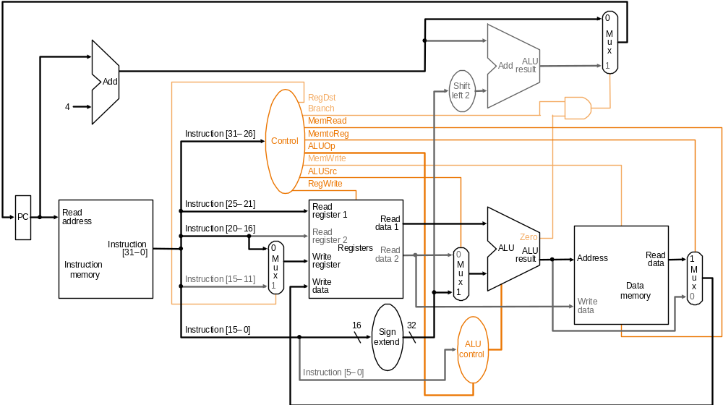
Load Instruction lw $t1, offset($t2)

Slide 61
Branch Instruction Steps beq $t1, $t2, offset
Fetch instruction and increment PC
Read two register ($t1 and $t2) from the register file
ALU performs a subtract on the data values from the register file; the value of PC+4 is added to the sign-extended lower 16 bits (offset) of the instruction shifted left by two to give the branch target address
The Zero result from the ALU is used to decide which adder result (from step 1 or 3) to store in the PC

Slide 62
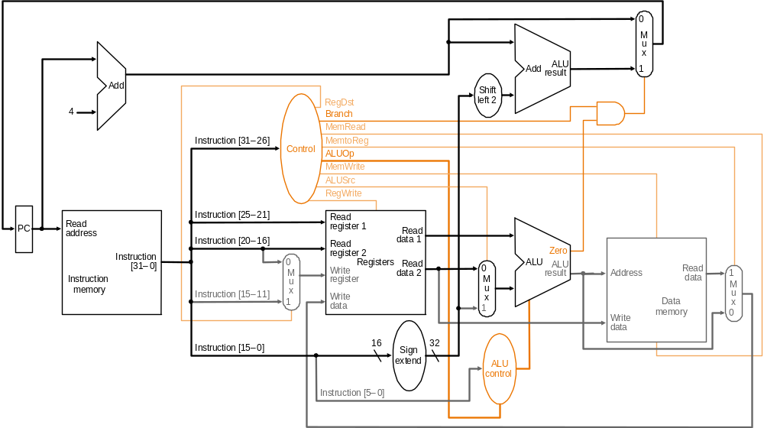
Branch Instruction beq $t1, $t2, offset

Slide 63
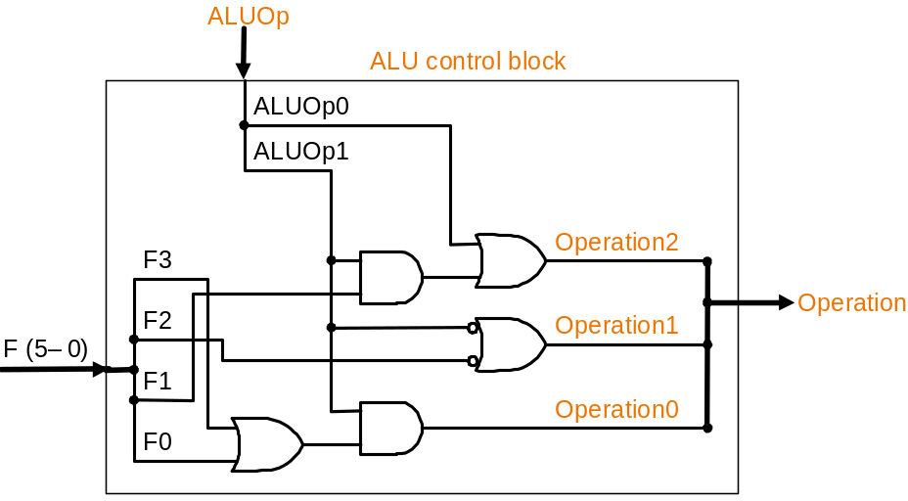
Implementation: ALU Control Block
ALUOp
Funct field
Operation
ALUOp1
ALUOp0
F5
F4
F3
F2
F1
F0
0
0
X
X
X
X
X
X
010
*Typo in text
Fig. 5.15: if it is X
then there is potential
conflict between
line 2 and lines 3-7!
*
0
1
X
X
X
X
X
X
110
1
X
X
X
0
0
0
0
010
1
X
X
X
0
0
1
0
110
1
X
X
X
0
1
0
0
000
1
X
X
X
0
1
0
1
001
1
X
X
X
1
0
1
0
111
Truth table for ALU control bits
ALU control logic

Slide 64
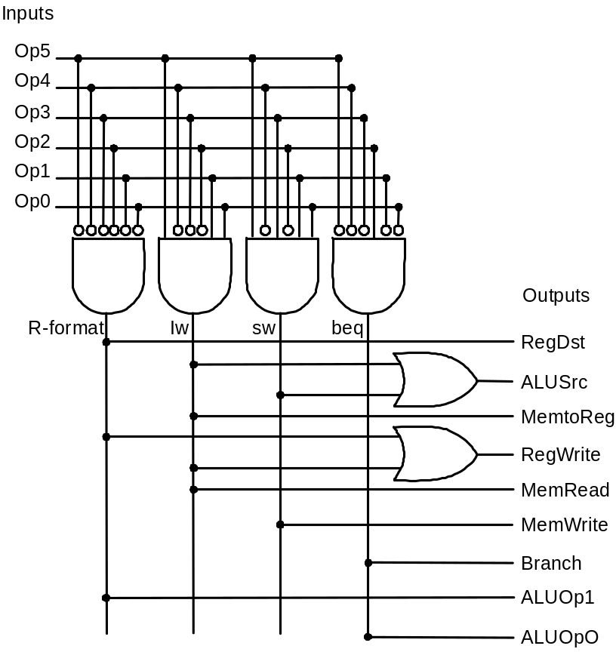
Implementation: Main Control Block
Signal R- lw sw beq
name format
Op5 0 1 1 0
Op4 0 0 0 0
Op3 0 0 1 0
Op2 0 0 0 1
Op1 0 1 1 0
Op0 0 1 1 0
RegDst 1 0 x x
ALUSrc 0 1 1 0
MemtoReg 0 1 x x
RegWrite 1 1 0 0
MemRead 0 1 0 0
MemWrite 0 0 1 0
Branch 0 0 0 1
ALUOp1 1 0 0 0
ALUOP2 0 0 0 1
Inputs
Outputs
Main control PLA (programmable
logic array): principle underlying
PLAs is that any logical expression
can be written as a sum-of-products
Truth table for main control signals

Slide 65
Single-Cycle Design Problems
Assuming fixed-period clock every instruction datapath uses one clock cycle implies:
  CPI = 1
  cycle time determined by length of the longest instruction path (load)
    but several instructions could run in a shorter clock cycle: waste of time
    consider if we have more complicated instructions like floating point!
  resources used more than once in the same cycle need to be duplicated
    waste of hardware and chip area

Slide 66
Example: Fixed-period clock vs. variable-period clock in a single-cycle implementation
Consider a machine with an additional floating point unit. Assume functional unit delays as follows
  memory: 2 ns., ALU and adders: 2 ns., FPU add: 8 ns., FPU multiply: 16 ns., register file access (read or write): 1 ns.
  multiplexors, control unit, PC accesses, sign extension, wires: no delay
Assume instruction mix as follows
  all loads take same time and comprise 31%
  all stores take same time and comprise 21%
  R-format instructions comprise 27%
  branches comprise 5%
  jumps comprise 2%
  FP adds and subtracts take the same time and totally comprise 7%
  FP multiplys and divides take the same time and totally comprise 7%
Compare the performance of (a) a single-cycle implementation using a fixed-period clock with (b) one using a variable-period clock where each instruction executes in one clock cycle that is only as long as it needs to be (not really practical but pretend it’s possible!)

Slide 67
Solution
Instruction Instr. Register ALU Data Register FPU FPU Total
class mem. read oper. mem. write add/ mul/ time
sub div ns.
Load word 2 1 2 2 1 8
Store word 2 1 2 2 7
R-format 2 1 2 0 1 6
Branch 2 1 2 5
Jump 2 2
FP mul/div 2 1 1 16 20
FP add/sub 2 1 1 8 12
Clock period for fixed-period clock = longest instruction time = 20 ns.
Average clock period for variable-period clock = 8 × 31% +
7 × 21% + 6 × 27% + 5 × 5% + 2 × 2% + 20 × 7% + 12 × 7%
= 7.0 ns.
Therefore, performance_{var-period} /performance_{fixed-period} = 20/7 = 2.9

Slide 68
Fixing the problem with single-cycle designs
One solution: a variable-period clock with different cycle times for each instruction class
  unfeasible, as implementing a variable-speed clock is technically difficult
Another solution:
  use a smaller cycle time…
  …have different instructions take different numbers of cycles
  by breaking instructions into steps and fitting each step into one cycle
  feasible: multicyle approach!

Slide 69
Multicycle Approach
Break up the instructions into steps
  each step takes one clock cycle
  balance the amount of work to be done in each step/cycle so that they are about equal
  restrict each cycle to use at most once each major functional unit so that such units do not have to be replicated
  functional units can be shared between different cycles within one instruction
Between steps/cycles
  At the end of one cycle store data to be used in later cycles of the same instruction
    need to introduce additional internal (programmer-invisible) registers for this purpose
  Data to be used in later instructions are stored in programmer-visible state elements: the register file, PC, memory

Slide 70
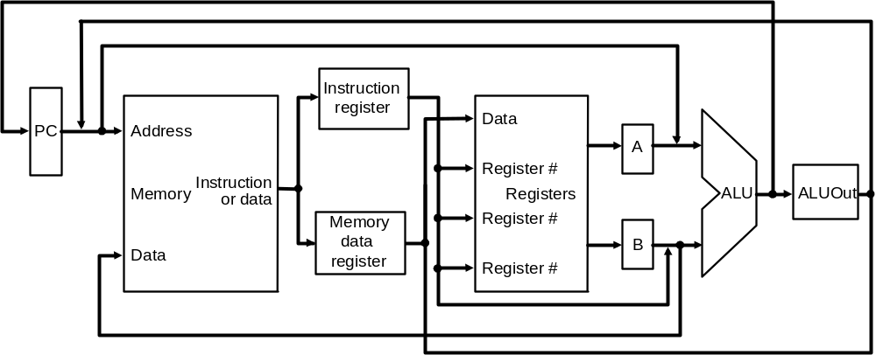
Multicycle Approach
Note particularities of
multicyle vs. single-
diagrams
  single memory for data
  and instructions
  single ALU, no extra adders
  extra registers to
  hold data between
  clock cycles
Single-cycle datapath
Multicycle datapath (high-level view)

Slide 71
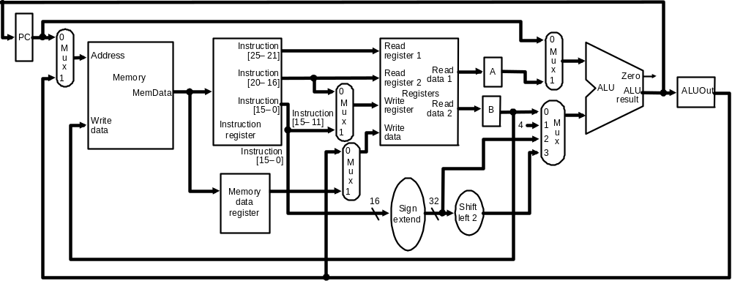
Multicycle Datapath
Basic multicycle MIPS datapath handles R-type instructions and load/stores:
new internal register in red ovals, new multiplexors in blue ovals

Slide 72
Breaking instructions into steps
Our goal is to break up the instructions into steps so that
  each step takes one clock cycle
  the amount of work to be done in each step/cycle is about equal
  each cycle uses at most once each major functional unit so that such units do not have to be replicated
  functional units can be shared between different cycles within one instruction
Data at end of one cycle to be used in next must be stored !!

Slide 73
Breaking instructions into steps
We break instructions into the following potential execution steps – not all instructions require all the steps – each step takes one clock cycle
  Instruction fetch and PC increment (IF)
  Instruction decode and register fetch (ID)
  Execution, memory address computation, or branch completion (EX)
  Memory access or R-type instruction completion (MEM)
  Memory read completion (WB)
Each MIPS instruction takes from 3 – 5 cycles (steps)

Slide 74
Step 1: Instruction Fetch & PC Increment (IF)
Use PC to get instruction and put it in the instruction register.
Increment the PC by 4 and put the result back in the PC.
Can be described succinctly using RTL (Register-Transfer Language):
IR = Memory[PC];
PC = PC + 4;

Slide 75
Step 2: Instruction Decode and Register Fetch (ID)
Read registers rs and rt in case we need them.
Compute the branch address in case the instruction is a branch.
RTL:
A = Reg[IR[25-21]];
B = Reg[IR[20-16]];
ALUOut = PC + (sign-extend(IR[15-0]) << 2);

Slide 76
Step 3: Execution, Address Computation or Branch Completion (EX)
ALU performs one of four functions depending on instruction type
  memory reference:
  ALUOut = A + sign-extend(IR[15-0]);
  R-type:
  ALUOut = A op B;
  branch (instruction completes):
  if (A==B) PC = ALUOut;
  jump (instruction completes):
  PC = PC[31-28] || (IR(25-0) << 2)

Slide 77
Step 4: Memory access or R-type Instruction Completion
(MEM)
Again depending on instruction type:
Loads and stores access memory
  load
  MDR = Memory[ALUOut];
  store (instruction completes)
  Memory[ALUOut] = B;
R-type (instructions completes)
Reg[IR[15-11]] = ALUOut;

Slide 78
Step 5: Memory Read Completion (WB)
Again depending on instruction type:
Load writes back (instruction completes)
Reg[IR[20-16]]= MDR;
Important: There is no reason from a datapath (or control) point of view that Step 5 cannot be eliminated by performing
Reg[IR[20-16]]= Memory[ALUOut];
for loads in Step 4. This would eliminate the MDR as well.
The reason this is not done is that, to keep steps balanced in length, the design restriction is to allow each step to contain at most one ALU operation, or one register access, or one memory access.

Slide 79
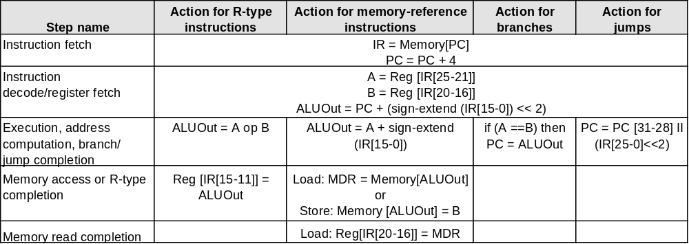
Summary of Instruction Execution
Step
1: IF
2: ID
3: EX
4: MEM
5: WB

Slide 80
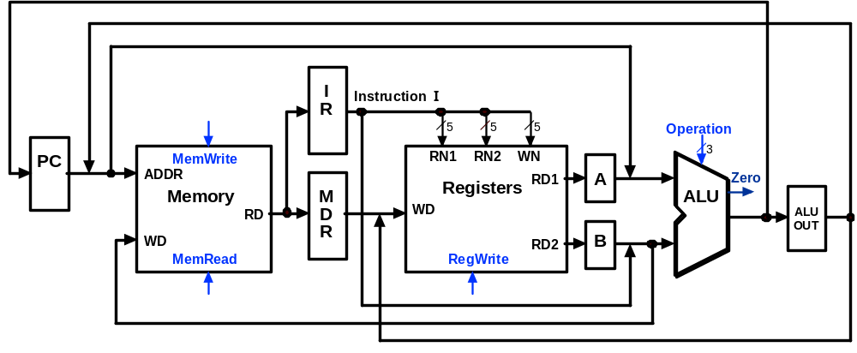
Multicycle Execution Step (1):
Instruction Fetch
IR = Memory[PC];
PC = PC + 4;
4
PC + 4

Slide 81
Multicycle Execution Step (2):
Instruction Decode & Register Fetch
A = Reg[IR[25-21]]; (A = Reg[rs])
B = Reg[IR[20-15]]; (B = Reg[rt])
ALUOut = (PC + sign-extend(IR[15-0]) << 2)
Reg[rs]
Branch
Target
Address
PC + 4
Reg[rt]

Slide 82
Multicycle Execution Step (3):
Memory Reference Instructions
ALUOut = A + sign-extend(IR[15-0]);
Reg[rs]
Mem.
Address
PC + 4
Reg[rt]

Slide 83
Multicycle Execution Step (3):
ALU Instruction (R-Type)
ALUOut = A op B
Reg[rs]
R-Type
Result
PC + 4
Reg[rt]

Slide 84
Multicycle Execution Step (3):
Branch Instructions
if (A == B) PC = ALUOut;
Reg[rs]
Branch
Target
Address
Branch
Target
Address
Reg[rt]

Slide 85
Multicycle Execution Step (3):
Jump Instruction
PC = PC[31-28] concat (IR[25-0] << 2)
Reg[rs]
Branch
Target
Address
Jump
Address
Reg[rt]

Slide 86
Multicycle Execution Step (4):
Memory Access - Read (lw)
MDR = Memory[ALUOut];
Reg[rs]
Mem.
Address
PC + 4
Mem.
Data
Reg[rt]

Slide 87
Multicycle Execution Step (4):
Memory Access - Write (sw)
Memory[ALUOut] = B;
Reg[rs]
PC + 4
Reg[rt]

Slide 88
Multicycle Execution Step (4):
ALU Instruction (R-Type)
Reg[IR[15:11]] = ALUOUT
Reg[rs]
R-Type
Result
PC + 4
Reg[rt]

Slide 89
Multicycle Execution Step (5):
Memory Read Completion (lw)
Reg[IR[20-16]] = MDR;
Reg[rs]
Mem.
Address
PC + 4
Mem.
Data
Reg[rt]

Slide 90
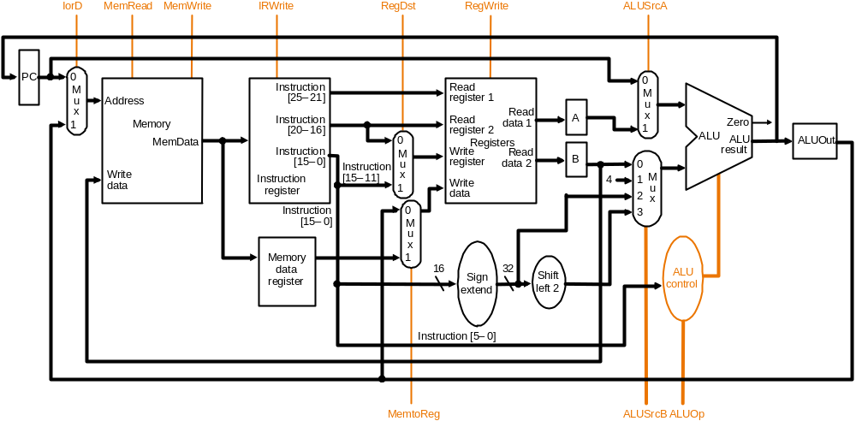
Multicycle Datapath with Control I
… with control lines and the ALU control block added – not all control lines are shown

Slide 91
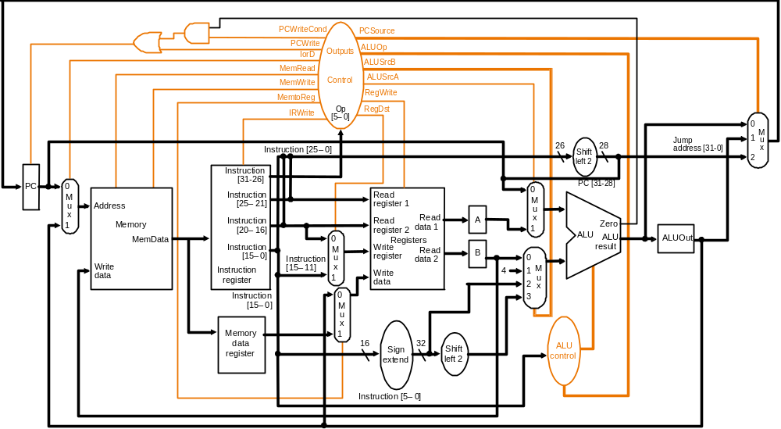
Multicycle Datapath with Control II
New gates
For the jump address
New multiplexor
Complete multicycle MIPS datapath (with branch and jump capability)
and showing the main control block and all control lines

Slide 92
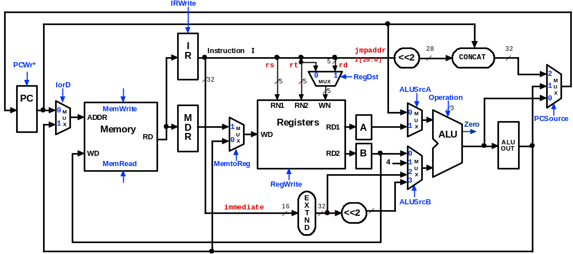
Multicycle Control Step (1):
Fetch
IR = Memory[PC];
PC = PC + 4;
1
1
0
0
0
X
010
0
X
1
0
1

Slide 93
Multicycle Control Step (2):
Instruction Decode & Register Fetch
A = Reg[IR[25-21]]; (A = Reg[rs])
B = Reg[IR[20-15]]; (B = Reg[rt])
ALUOut = (PC + sign-extend(IR[15-0]) << 2);
0
0
X
0
0
X
010
X
X
0
0
3

Slide 94
Multicycle Control Step (3):
Memory Reference Instructions
ALUOut = A + sign-extend(IR[15-0]);
0
0
X
1
0
X
010
X
X
0
0
2

Slide 95
Multicycle Control Step (3):
ALU Instruction (R-Type)
ALUOut = A op B;
0
0
X
1
0
X
???
X
X
0
0
0

Slide 96
Multicycle Control Step (3):
Branch Instructions
if (A == B) PC = ALUOut;
0
1 if
Zero=1
X
1
0
X
011
1
X
0
0
0

Slide 97
Multicycle Execution Step (3):
Jump Instruction
PC = PC[21-28] concat (IR[25-0] << 2);
0
1
X
X
0
X
XXX
2
X
0
0
X

Slide 98
Multicycle Control Step (4):
Memory Access - Read (lw)
MDR = Memory[ALUOut];
0
0
1
X
0
X
XXX
X
X
1
0
X

Slide 99
Multicycle Execution Steps (4)
Memory Access - Write (sw)
Memory[ALUOut] = B;
0
0
1
X
1
X
XXX
X
X
0
0
X

Slide 100
Multicycle Control Step (4):
ALU Instruction (R-Type)
Reg[IR[15:11]] = ALUOut; (Reg[Rd] = ALUOut)
0
IRWrite
0
I
Instruction
I
jmpaddr
28
32
R
5
I[25:0]
<<2
CONCAT
PCWr*
X
rs
rt
rd
0
32
5
5
0
MUX
1
RegDst
X
2
M
IorD
5
1
ALUSrcA
XXX
1
U
PC
Operation
0
X
0
M
MemWrite
RN1
RN2
WN
0
3
U
ADDR
M
Registers
M
PCSource
1
X
D
0
RD1
A
1
U
Zero
X
Memory
M
WD
X
ALU
RD
R
1
U
X
ALU
WD
RD2
B
0
OUT
MemRead
MemtoReg
4
1
M
1
2
U
RegWrite
3
X
0
1
E
ALUSrcB
immediate
16
X
32
<<2
X
T
N
D

Slide 101
Multicycle Execution Steps (5)
Memory Read Completion (lw)
Reg[IR[20-16]] = MDR;
IRWrite
0
0
I
Instruction
I
jmpaddr
28
32
R
5
I[25:0]
<<2
CONCAT
PCWr*
X
rs
rt
rd
X
0
32
0
1
RegDst
2
IorD
5
5
MUX
0
XXX
1
M
5
ALUSrcA
U
PC
Operation
0
X
0
M
MemWrite
RN1
RN2
WN
0
3
U
ADDR
M
Registers
M
PCSource
1
X
D
0
RD1
A
1
U
Zero
X
Memory
M
WD
X
ALU
RD
R
1
U
X
ALU
WD
RD2
B
0
OUT
MemRead
MemtoReg
4
1
M
0
2
U
0
RegWrite
3
X
1
E
ALUSrcB
immediate
16
X
32
<<2
X
T
N
D

Slide 102
Simple Questions
How many cycles will it take to execute this code?
lw $t2, 0($t3)
lw $t3, 4($t3)
beq $t2, $t3, Label #assume not equal
add $t5, $t2, $t3
sw $t5, 8($t3)
Label: ...
What is going on during the 8th cycle of execution?
In what cycle does the actual addition of $t2 and $t3 takes place?
Clock time-line

Slide 103
Implementing Control
Value of control signals is dependent upon:
  what instruction is being executed
  which step is being performed
Use the information we have accumulated to specify a finite state machine
  specify the finite state machine graphically, or
  use microprogramming
Implementation is then derived from the specification

Slide 104
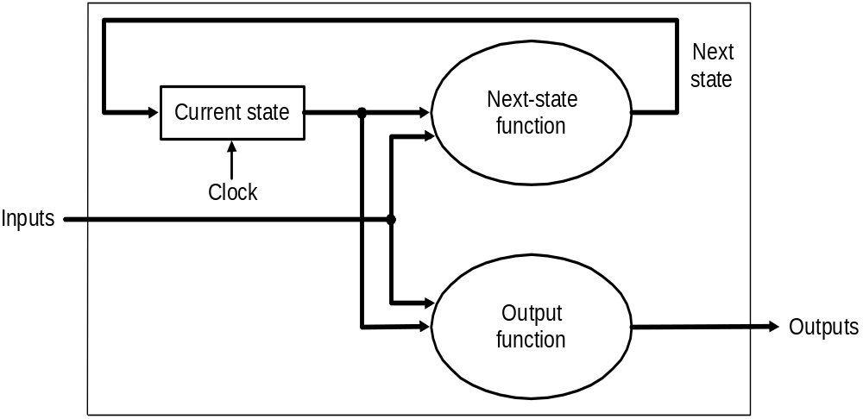
Review: Finite State Machines
Finite state machines (FSMs):
  a set of states and
  next state function, determined by current state and the input
  output function, determined by current state and possibly input
  We’ll use a Moore machine – output based only on current state

Slide 105
Example: Moore Machine
The Moore machine below, given input a binary string terminated by “#”, will output “even” if the string has an even number of 0’s and “odd” if the string has an odd number of 0’s
Even state
Odd state
1
1
No
output
0
No
output
0
Start
#
#
Output
“even”
Output
“odd”
Output even state
Output odd state

Slide 106
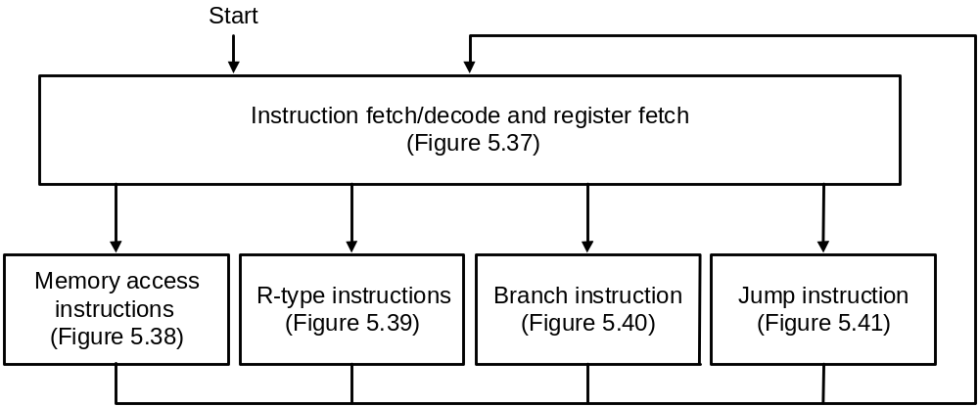
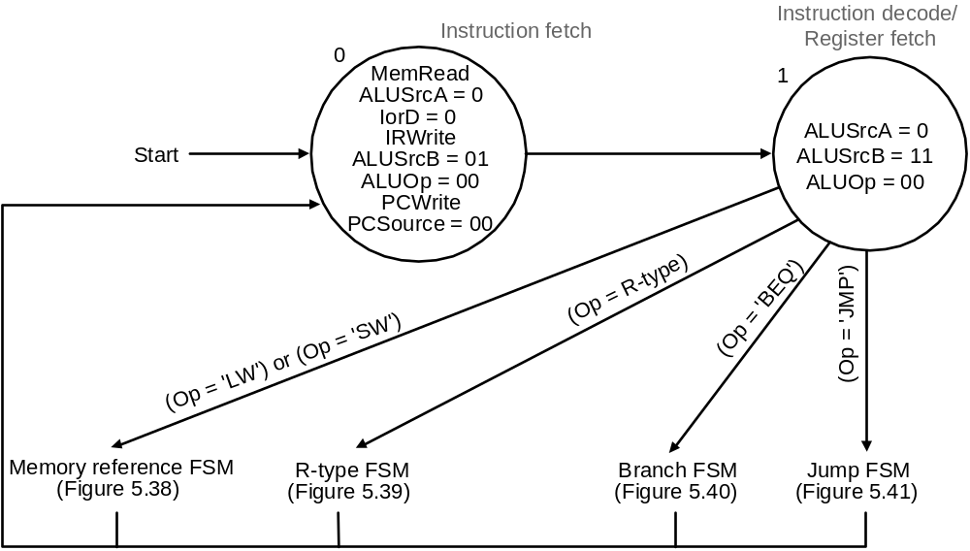
FSM Control: High-level View
High-level view of FSM control
Asserted signals
shown inside
state circles
Instruction fetch and decode steps of every instruction is identical

Slide 107

FSM Control: Memory Reference
FSM control for memory-reference has 4 states

Slide 108

FSM Control: R-type Instruction
FSM control to implement R-type instructions has 2 states

Slide 109

FSM Control: Branch Instruction
FSM control to implement branches has 1 state

Slide 110

FSM Control: Jump Instruction
FSM control to implement jumps has 1 state

Slide 111

FSM Control: Complete View
IF
ID
EX
MEM
Labels on arcs are conditions
that determine next state
WB
The complete FSM control for the multicycle MIPS datapath:
refer Multicycle Datapath with Control II

Slide 112
Example: CPI in a multicycle CPU
Assume
  the control design of the previous slide
  An instruction mix of 22% loads, 11% stores, 49% R-type operations, 16% branches, and 2% jumps
What is the CPI assuming each step requires 1 clock cycle?
Solution:
  Number of clock cycles from previous slide for each instruction class:
    loads 5, stores 4, R-type instructions 4, branches 3, jumps 3
  CPI = CPU clock cycles / instruction count
  = Σ (instruction count_{class i} × CPI_{class i}) / instruction count
  = Σ (instruction count_{class I} / instruction count) × CPI_{class I}
  = 0.22 × 5 + 0.11 × 4 + 0.49 × 4 + 0.16 × 3 + 0.02 × 3
  = 4.04

Slide 113

FSM Control:
Implement- ation
Four state bits are required for 10 states
High-level view of FSM implementation: inputs to the combinational logic block are
the current state number and instruction opcode bits; outputs are the next state
number and control signals to be asserted for the current state

Slide 114

FSM
Control:
PLA
Implem- entation
Upper half is the AND plane that computes all the products. The products are carried
to the lower OR plane by the vertical lines. The sum terms for each output is given by
the corresponding horizontal line
E.g., IorD = S0.S1.S2.S3 + S0.S1.S2.S3

Slide 115
FSM Control: ROM Implementation
ROM (Read Only Memory)
  values of memory locations are fixed ahead of time
A ROM can be used to implement a truth table
  if the address is m-bits, we can address 2^{m} entries in the ROM
  outputs are the bits of the entry the address points to
address
output
0 0 0 0 0 1 1
0 0 1 1 1 0 0
0 1 0 1 1 0 0
0 1 1 1 0 0 0
1 0 0 0 0 0 0
1 0 1 0 0 0 1
1 1 0 0 1 1 0
1 1 1 0 1 1 1
m
n
ROM
m = 3
n = 4
The size of an m-input n-output ROM is 2^{m} x n bits – such a ROM can
be thought of as an array of size 2^{m} with each entry in the array being
n bits

Slide 116
FSM Control: ROM vs. PLA
First improve the ROM: break the table into two parts
  4 state bits give the 16 output signals – 2⁴ x 16 bits of ROM
  all 10 input bits give the 4 next state bits – 2¹⁰ x 4 bits of ROM
  Total – 4.3K bits of ROM
PLA is much smaller
  can share product terms
  only need entries that produce an active output
  can take into account don't cares
PLA size = (#inputs × #product-terms) + (#outputs × #product-terms)
  FSM control PLA = (10x17)+(20x17) = 460 PLA cells
PLA cells usually about the size of a ROM cell (slightly bigger)

Slide 117
Microprogramming
Microprogramming is a method of specifying FSM control that resembles a programming language – textual rather graphic
  this is appropriate when the FSM becomes very large, e.g., if the instruction set is large and/or the number of cycles per instruction is large
  in such situations graphical representation becomes difficult as there may be thousands of states and even more arcs joining them
  a microprogram is specification : implementation is by ROM or PLA
A microprogram is a sequence of microinstructions
  each microinstruction has eight fields (label + 7 functional)
    Label: used to control microcode sequencing
    ALU control: specify operation to be done by ALU
    SRC1: specify source for first ALU operand
    SRC2: specify source for second ALU operand
    Register control: specify read/write for register file
    Memory: specify read/write for memory
    PCWrite control: specify the writing of the PC
    Sequencing: specify choice of next microinstruction

Slide 118
Microprogramming
The Sequencing field value determines the execution order of the microprogram
  value Seq : control passes to the sequentially next microinstruction
  value Fetch : branch to the first microinstruction to begin the next MIPS instruction, i.e., the first microinstruction in the microprogram
  value Dispatch i : branch to a microinstruction based on control input and a dispatch table entry (called dispatching):
    Dispatching is implemented by means of creating a table, called dispatch table, whose entries are microinstruction labels and which is indexed by the control input. There may be multiple dispatch tables – the value Dispatch i in the sequencing field indicates that the i th dispatch table is to be used

Slide 119

Control Microprogram
The microprogram corresponding to the FSM control shown graphically earlier:
Microprogram containing 10 microinstructions
Dispatch ROM 1
Op
Opcode name
Value
Dispatch ROM 2
000000
R-format
Rformat1
Op
Opcode name
Value
000010
jmp
JUMP1
100011
lw
LW2
000100
beq
BEQ1
101011
sw
SW2
100011
lw
Mem1
Dispatch Table 2
101011
sw
Mem1
Dispatch Table 1

Slide 120
Microcode: Trade-offs
Specification advantages
  easy to design and write
  typically manufacturer designs architecture and microcode in parallel
Implementation advantages
  easy to change since values are in memory (e.g., off-chip ROM)
  can emulate other architectures
  can make use of internal registers
Implementation disadvantages
  control is implemented nowadays on same chip as processor so the advantage of an off-chip ROM does not exist
  ROM is no longer faster than on-board cache
  there is little need to change the microcode as general-purpose computers are used far more nowadays than computers designed for specific applications

Slide 121
Summary
Techniques described in this chapter to design datapaths and control are at the core of all modern computer architecture
Multicycle datapaths offer two great advantages over single-cycle
  functional units can be reused within a single instruction if they are accessed in different cycles – reducing the need to replicate expensive logic
  instructions with shorter execution paths can complete quicker by consuming fewer cycles
Modern computers, in fact, take the multicycle paradigm to a higher level to achieve greater instruction throughput:
  pipelining (next topic) where multiple instructions execute simultaneously by having cycles of different instructions overlap in the datapath
  the MIPS architecture was designed to be pipelined

